Slide 1


SIMATS ENGINEERIN
Saveetha Institute of Medical and Technical Sciences Chennai-602105
Department of Computer Science And Engineering
NLP Based AI-Food Recipe Generator Based On Recommendation
Supervisor:
Dr. Anbazhagan K
Presented By:
N Goutham(192472024)
A Shiva Shankar Reddy(192425174)
B.V.N.S.BHIMESWAR (192472048)
M.Tarun Prasad (192425024)
N.Lokesh(192425327)

Slide 2
OVERVIEW
□ABSTRACT
□INTRODUCTION
□LITERATURE SURVEY
□EXISTING SYSTEM
□PROBLEM IDENTIFICATION
□PROPOSED SYSTEM
□SYSTEM CONFIGURATION
□ARCHITECTURE DIAGRAM
□ALGORITHM
□FLOW CHART
□METHODOLODY - 1.1 LIST OF MODULES
□BRIEF EXPLANATION OF MODULES
□CODING & SCREENSHOT
□CONCLUSION & FUTURE ENHANCEMENT
□REFERENCES

Slide 3
ABSTRACT
Develop an NLP-based system for intelligent food recipe recommendation and diet planning.
Recommend suitable recipes based on the user's available ingredients and preferences.
Apply NLP preprocessing to clean, tokenize, and lemmatize ingredient text.
Use TF-IDF and Cosine Similarity to identify and rank relevant recipes.
Analyze nutritional values and diet goals for personalized meal recommendations.
Provide multilingual recipe output along with history and favorites management.

Slide 4



INTRODUCTION
Choosing suitable recipes is difficult due to varying food preferences and dietary needs.
Users need personalized meals based on ingredients, meal type, age, and diet goals.
Existing platforms may not effectively match recipes with available ingredients.
Nutritional values are essential for planning healthy and balanced meals.
NLP and AI enable personalized recipe recommendations and multilingual diet planning.

Slide 5
LITERATURE SURVEY
S.No | Author Name | Year | Paper Title | Method / Focus | Limitations
1 | M. A. et al. | 2023 | RecipeIS—Recipe Recommendation System Based on Recognition of Food Ingredients | Ingredient-based recipe recommendation | Limited focus on personalized nutrition planning
2 | K. Zioutos et al. | 2024 | Healthy Personalized Recipe Recommendations for Weekly Meal Planning | Hybrid collaborative and content-based recommendation | Requires detailed user and health information
3 | Y. Lao et al. | 2024 | Dynamic Personalized Recipe Recommendations Based on Facial Health Recognition | Health-aware personalized recipe recommendation | Depends on facial health recognition complexity
4 | Z. Yang et al. | 2024 | ChatDiet: Personalized Nutrition-Oriented Food Recommender Chatbots | LLM-based conversational nutrition recommendation | Higher computational complexity and LLM dependency
5 | J. Wong & Y. Yoannita | 2026 | TF-IDF and Cosine Similarity for Indonesian Recipe Recommendation | TF-IDF, preprocessing and Cosine Similarity | Limited advanced nutrition and multilingual features

Slide 6
EXISTING SYSTEM
Existing recipe platforms provide a large number of recipes with limited personalization.
Users must manually search for recipes using their available ingredients.
Ingredient names entered in different forms may not be matched effectively.
Many systems focus only on recipe recommendation or nutrition analysis separately.
Personalized diet goals are not always considered during recipe selection.
Multilingual support and integrated history management are often limited.

Slide 7

PROBLEM IDENTIFICATION
Users struggle to find recipes matching their available ingredients and dietary goals.
Existing recipe platforms provide limited personalization and nutrition-based recommendations.
There is a need for an NLP-based system that recommends suitable recipes and personalized diet plans.
The system should also provide multilingual and easy-to-understand recipe information.
Users lack a simple system that combines recipe recommendations with personalized nutritional and diet planning.

Slide 8
PROPOSED SYSTEM
Accepts ingredients, meal type, diet goals, age group, and language preferences.
Applies NLP preprocessing to clean and normalize user-entered text.
Uses TF-IDF to convert ingredient text into numerical vectors.
Uses Cosine Similarity to identify and rank relevant recipes.
Analyzes nutrition and applies rule-based filtering for diet recommendations.
Provides multilingual recipes with favorites and history management.

Slide 9
SYSTEM CONFIGURATION
Hardware Requirements
Processor: Intel Core i3 or above
RAM: 4 GB minimum, 8 GB recommended
Storage: 10 GB free disk space
Input Devices: Keyboard and Mouse
Internet: Required for Recipe API access

Slide 10
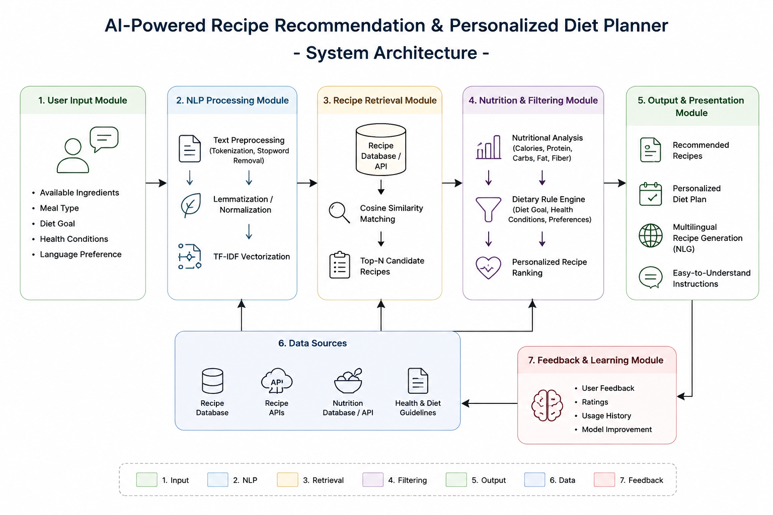
SYSTEM ARCHITECTURE

Slide 11
ALGORITHM
1. TF-IDF Vectorization Algorithm
Used to convert processed user ingredients and recipe ingredients into numerical vectors based on word importance.
Flow:
Processed Text → TF-IDF Vector → Numerical Representation
2. Rule-Based Recommendation Algorithm
Uses predefined conditions to filter recipes according to nutritional values and user diet goals.
Example:
IF diet goal = High Protein AND protein ≥ required value → Recommend
IF diet goal = Low Calorie AND calories ≤ limit → Recommend

Slide 12
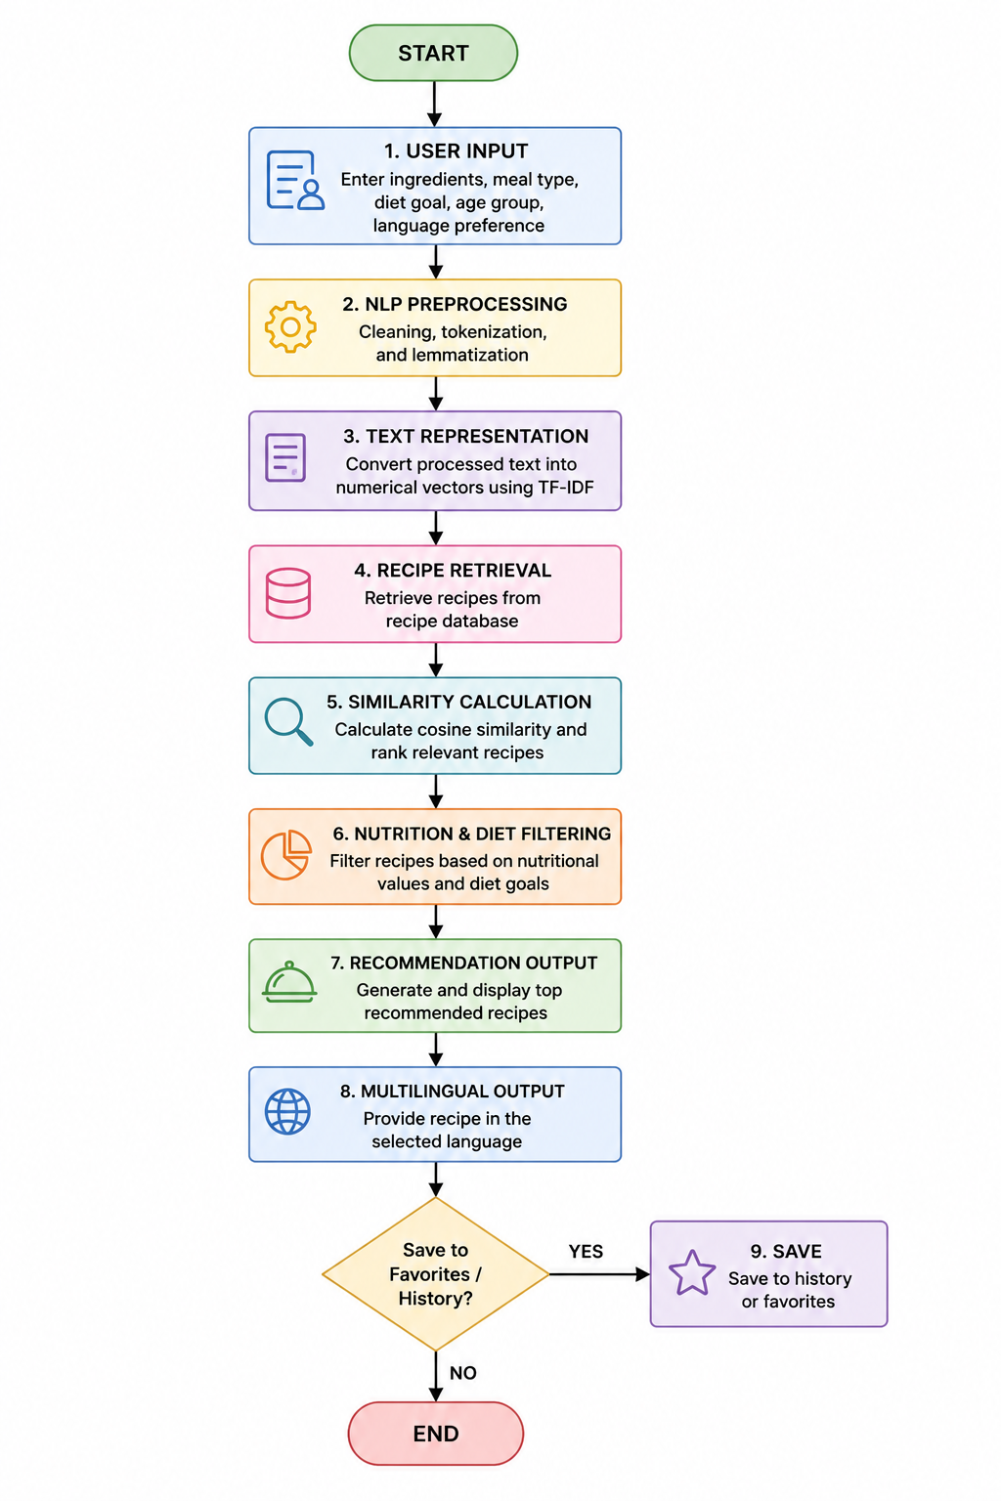
FLOW CHART

Slide 13
LIST OF MODULES
User Input & NLP Processing Module
Recipe Retrieval & Recommendation
Nutrition Analysis & Personalized Diet Planning Module
Recipe Generation, Multilingual Output & History Module
User Profile, History & Favorites Management

Slide 14
Module-1 User Input & NLP Processing Module
Collect user details including age group, meal type, diet goal, ingredients, and preferred language.
Process and clean the entered ingredient text by removing unwanted words and characters.
Tokenize the ingredient text into individual words for further NLP processing.
Apply lemmatization to convert different ingredient forms into their basic words.
Identify and extract important ingredients from the processed user input.
Convert the processed ingredient text into numerical vectors using TF-IDF.

Slide 15
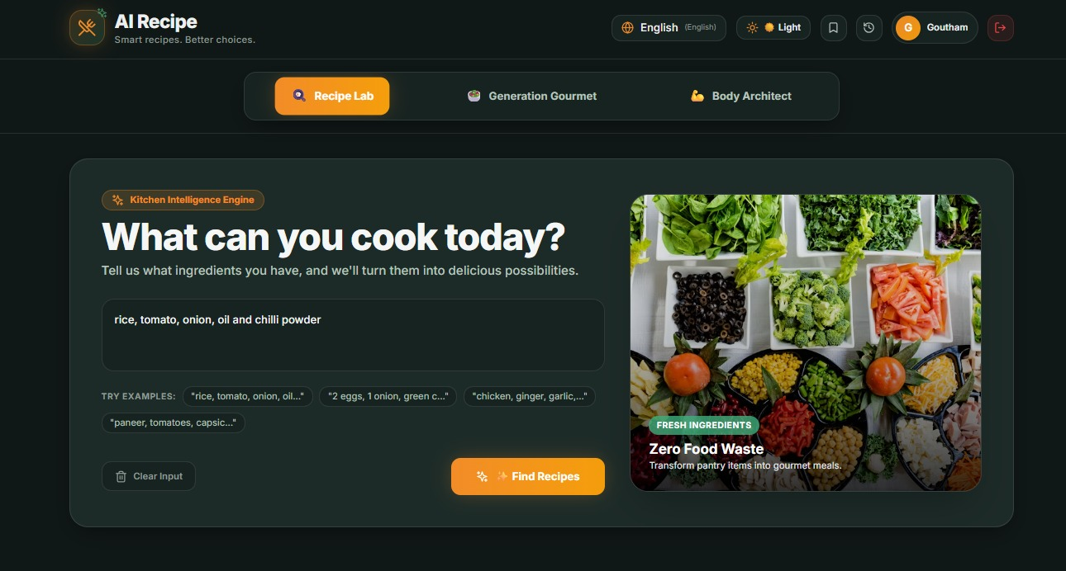
Module 1 : OUTPUT

Slide 16
Module-2 Recipe Retrieval & Recommendation
Retrieve suitable recipes dynamically from the integrated recipe API based on user requirements.
Compare the user's available ingredients with ingredients present in retrieved recipes.
Calculate the similarity between user input and recipes using Cosine Similarity.
Rank the retrieved recipes according to their matching similarity scores.
Apply user preferences such as meal type and diet type during recipe selection.
Display the top relevant recipes as personalized recommendations.

Slide 17
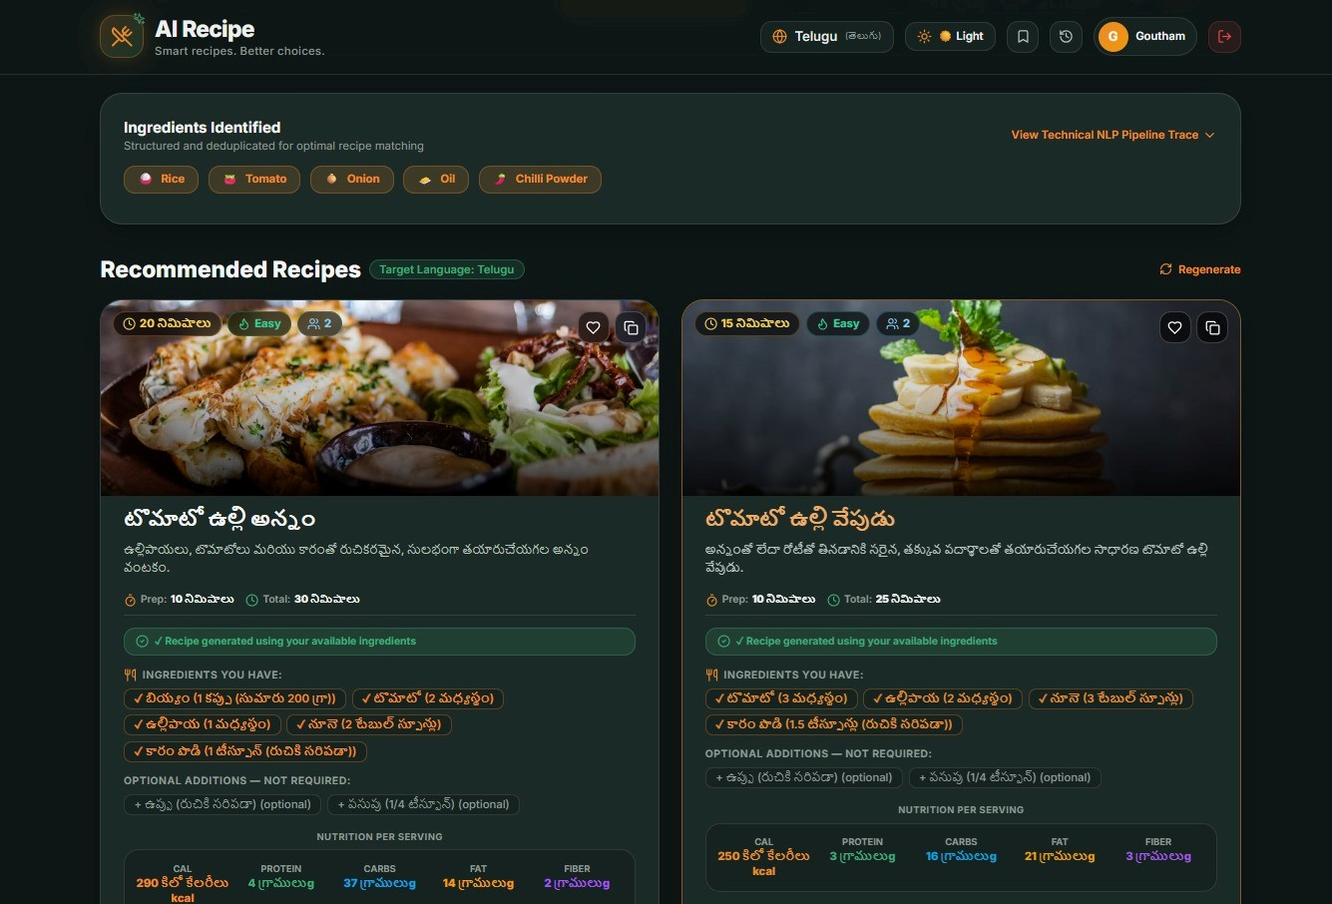
Module-2 : OUTPUT

Slide 18
Module-3 Nutrition Analysis & Personalized Diet Planning Module
Analyze nutritional values including calories, protein, carbohydrates, fat, and fiber.
Consider the user's selected diet goal while evaluating recommended recipes.
Filter recipes according to the user's required nutritional preferences and restrictions.
Apply predefined nutritional and dietary rules for personalized recommendations.
Combine suitable recipes to generate a personalized daily or weekly meal plan.
Provide healthy meal suggestions that match the user's nutritional requirements.

Slide 19
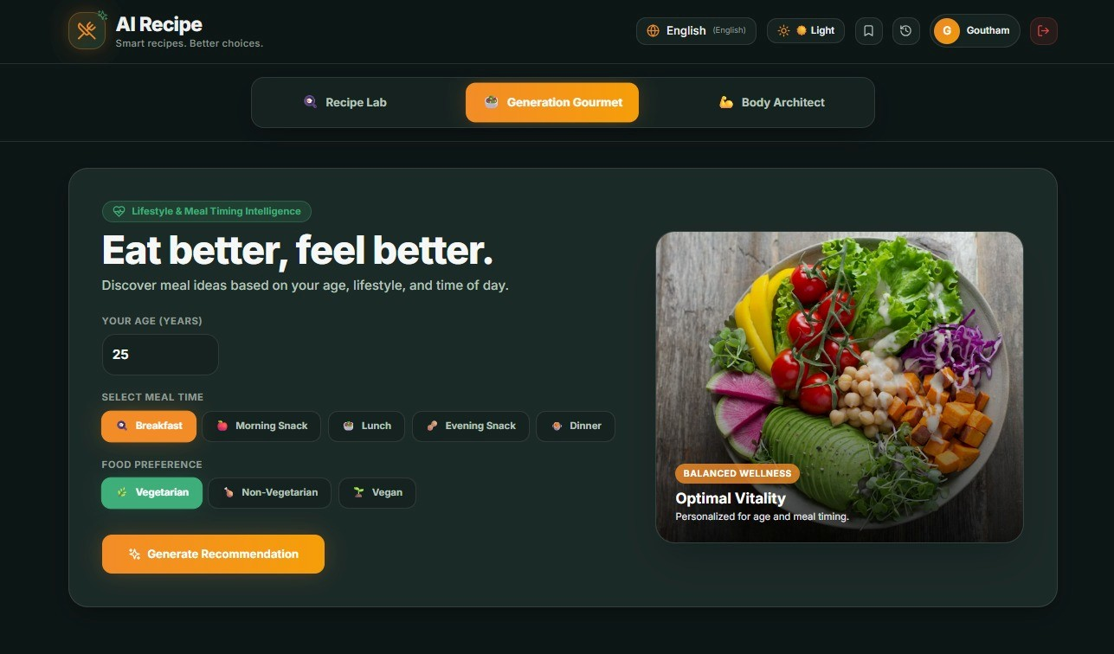
Module-3 OUTPUT

Slide 20
Module-4 Recipe Generation, Multilingual Output & History Module
Generate clear and structured recipe information from the selected recipe details.
Use Natural Language Generation to produce simple and human-readable cooking instructions.
Translate recipe names, ingredients, and instructions into the user's preferred language.
Display complete recipe information including ingredients, quantities, and preparation steps.
Allow users to save recommended recipes as favorites for quick access later.
Maintain recipe history to help users view their previously accessed recommendations

Slide 21
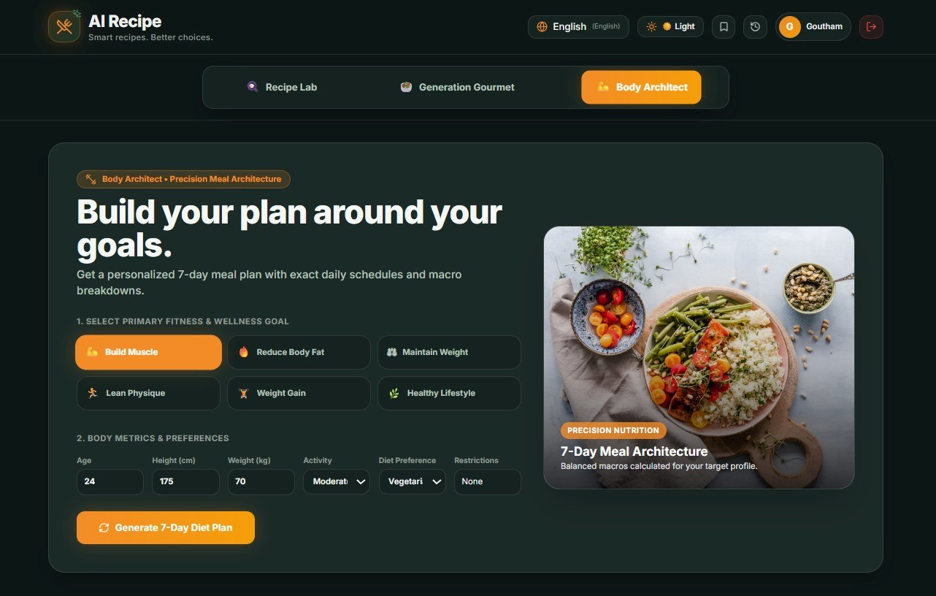
Module-4 Output

Slide 22
Module 5: User Profile, History & Favorites Management
Store user preferences such as diet goals, meal choices, and preferred language for future recommendations.
Maintain a history of previously searched, viewed, and recommended recipes for easy access.
Allow users to save their preferred recipes in a favorites section for future reference.
Use saved preferences and history to improve personalized recipe recommendations over time.
Enable users to revisit previously generated diet plans and recipe suggestions whenever required.
Manage user data securely to provide a more personalized and convenient system experience.

Slide 23
Module 5: Output

Slide 24
RESULT
The system successfully processes user-entered ingredient information using NLP techniques.
TF-IDF converts processed ingredient text into numerical representations.
Cosine Similarity identifies recipes that closely match available ingredients.
Nutrition-based filtering improves the relevance of recommended meals.
Personalized diet goals help users select healthier and suitable recipes.
Multilingual output and history features improve overall usability.

Slide 25
CONCLUSION
The system provides personalized recipe recommendations based on user ingredients and preferences.
NLP techniques improve ingredient matching and recipe retrieval.
Nutrition analysis helps users make healthier dietary choices.
Personalized meal plans support different dietary goals and nutritional needs.
Multilingual recipe generation makes the system accessible and user-friendly.

Slide 26
FUTURE ENHANCEMENT
Improve recipe recommendations by learning from user preferences and previous choices.
Add voice input to allow users to enter ingredients and preferences easily.
Provide detailed meal plans based on individual nutritional requirements.
Support more regional and international languages for better accessibility.
Recommend recipes based on specific health and dietary requirements.
Improve recommendations using user ratings, favorites, and feedback.

Slide 27
References
Mereddy, D., & Beedareddy, J. S. R. (2024), RecipeBERT: Personalized Food Recommendations, IEEE WI-IAT.
Nair, K. A., et al. (2024), Recipe-Fusion: Multimodal Food Recipe Recommendation System.
Pic2Plate: A Vision-Language and Retrieval-Augmented Framework for Personalized Recipe Recommendations (2025).
Sowdanya, C. S., et al. (2025), Recipe Recommendation Engine, ICRCET.
AI-Based Healthy Recipe Recommender Web Application for Diabetic Diets (2025).

Slide 28
THANK YOU

